Slide 1
Creating Calibrations

Slide 2
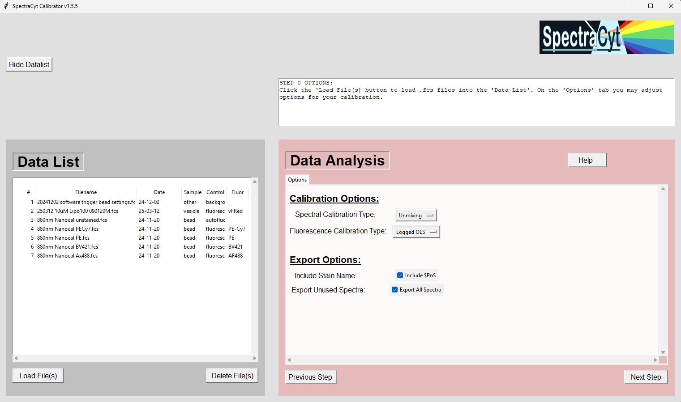

Slide 3
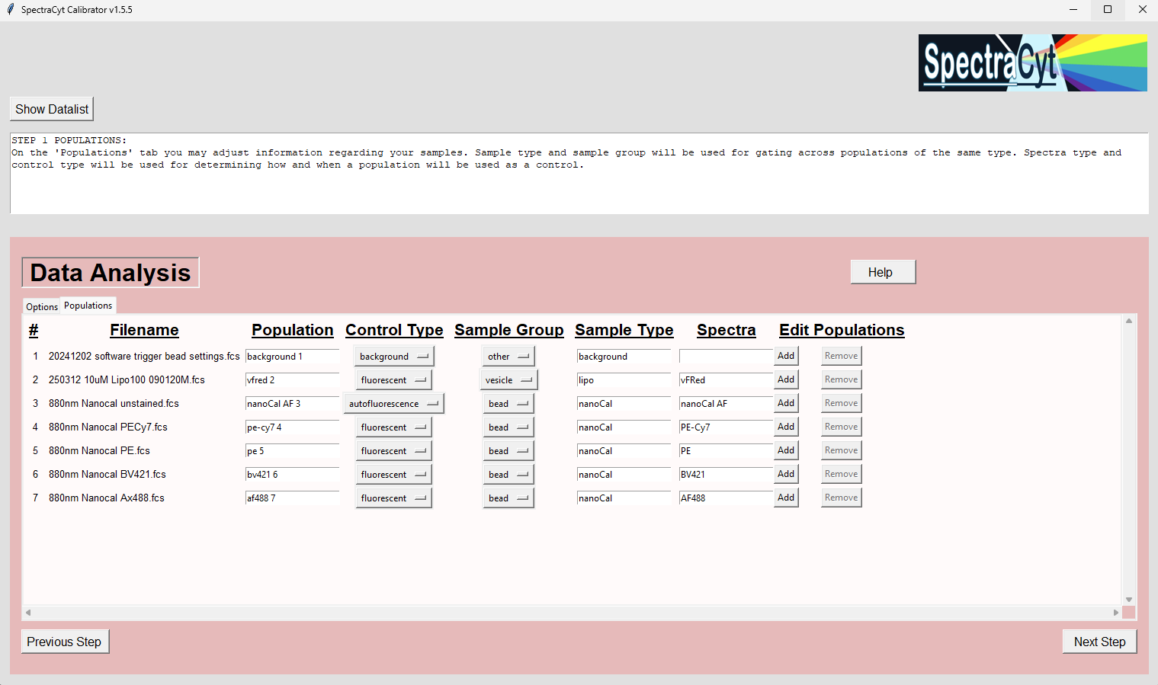

Slide 4
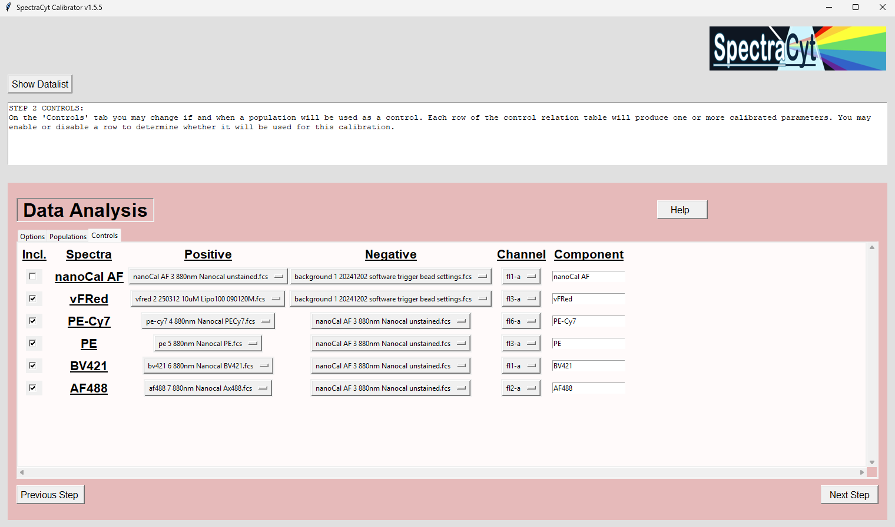

Slide 5
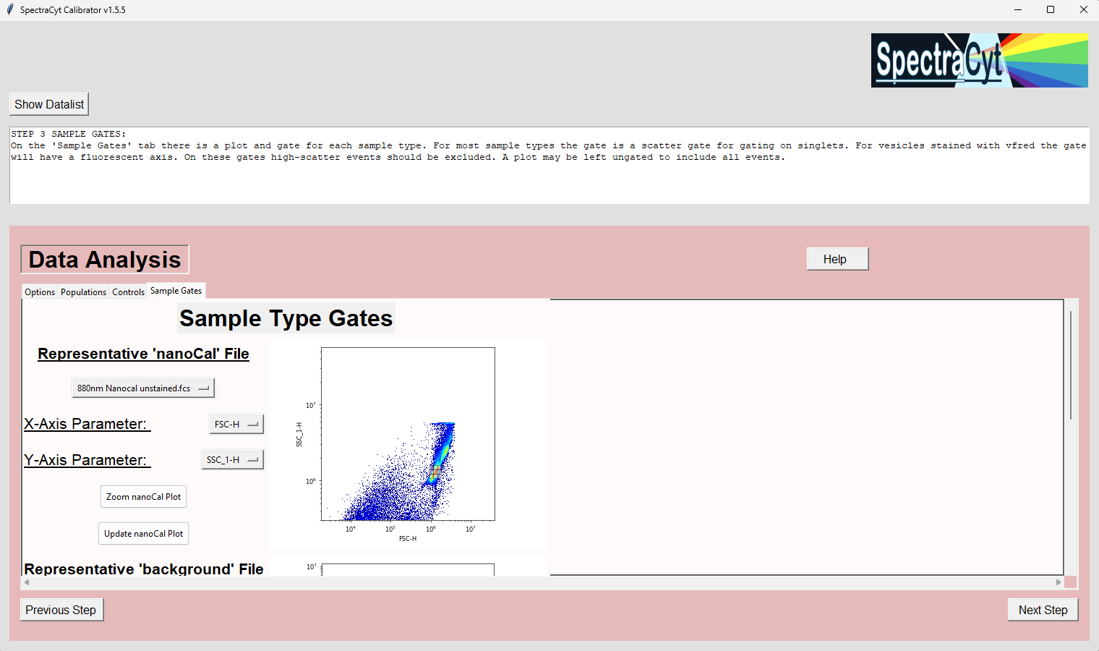

Slide 6
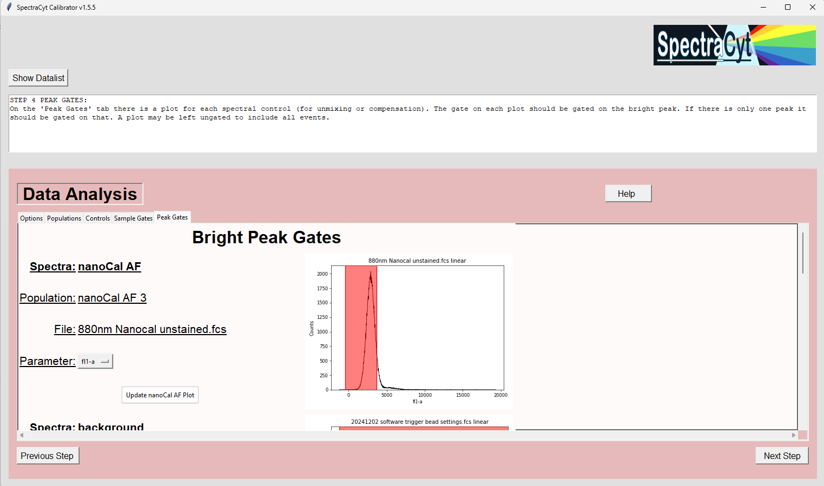

Slide 7
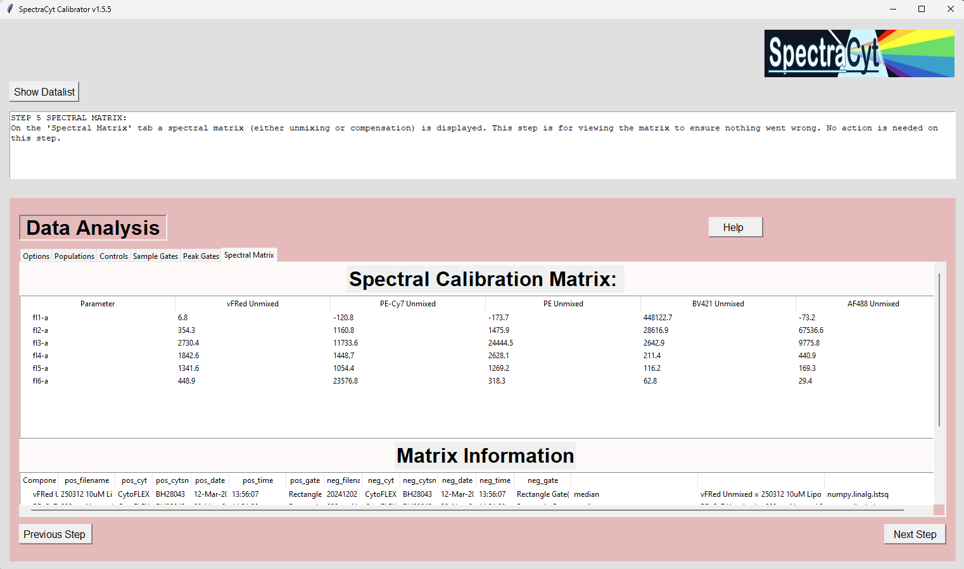

Slide 8
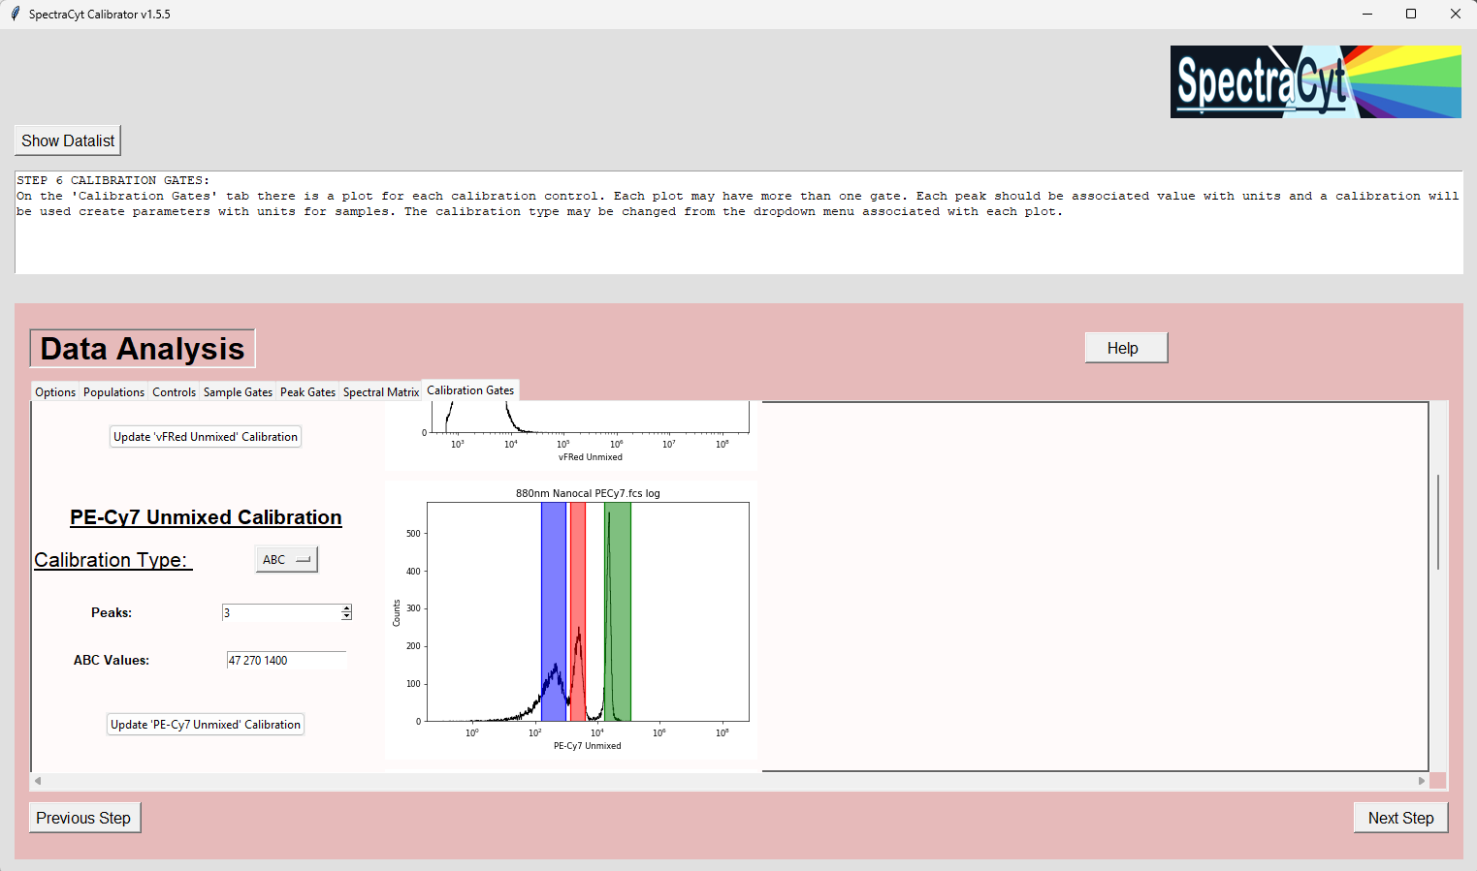

Slide 9
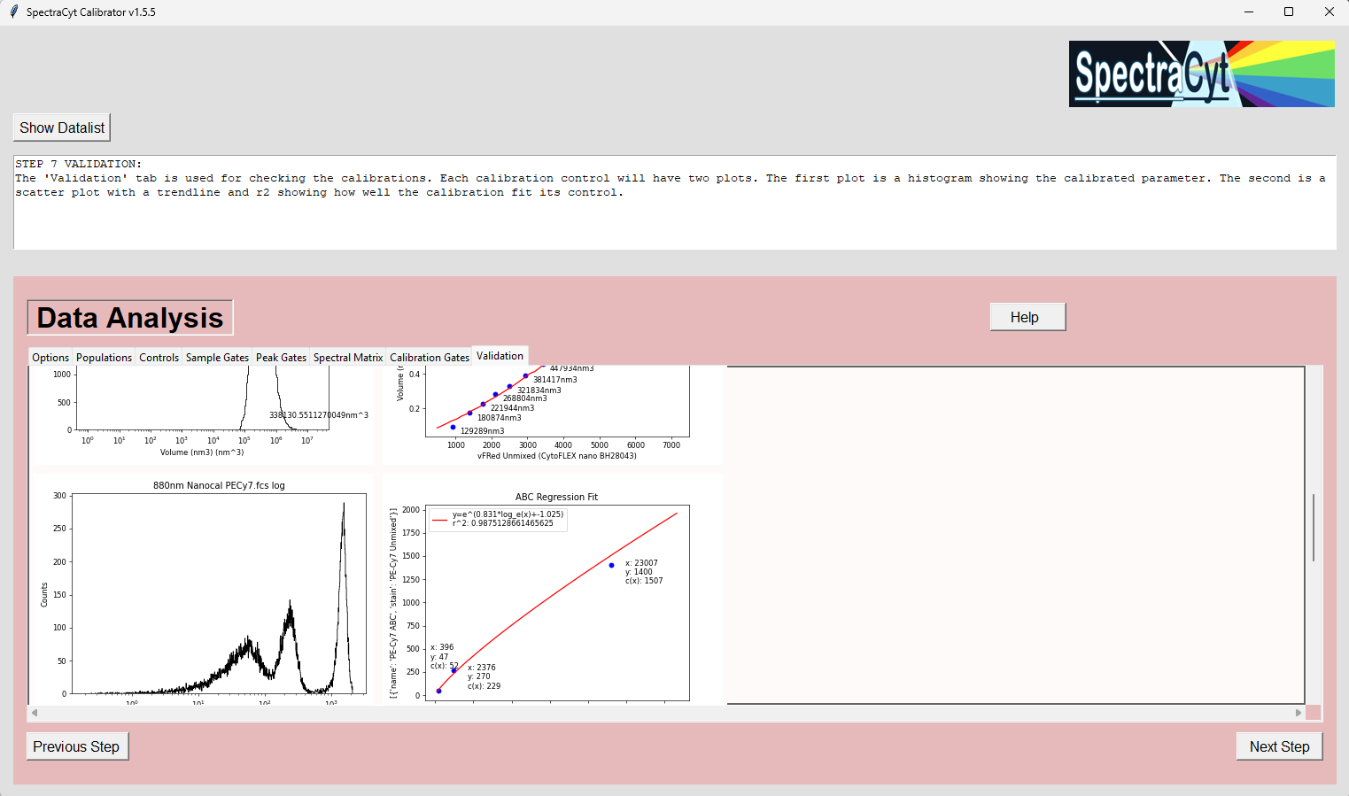

Slide 10
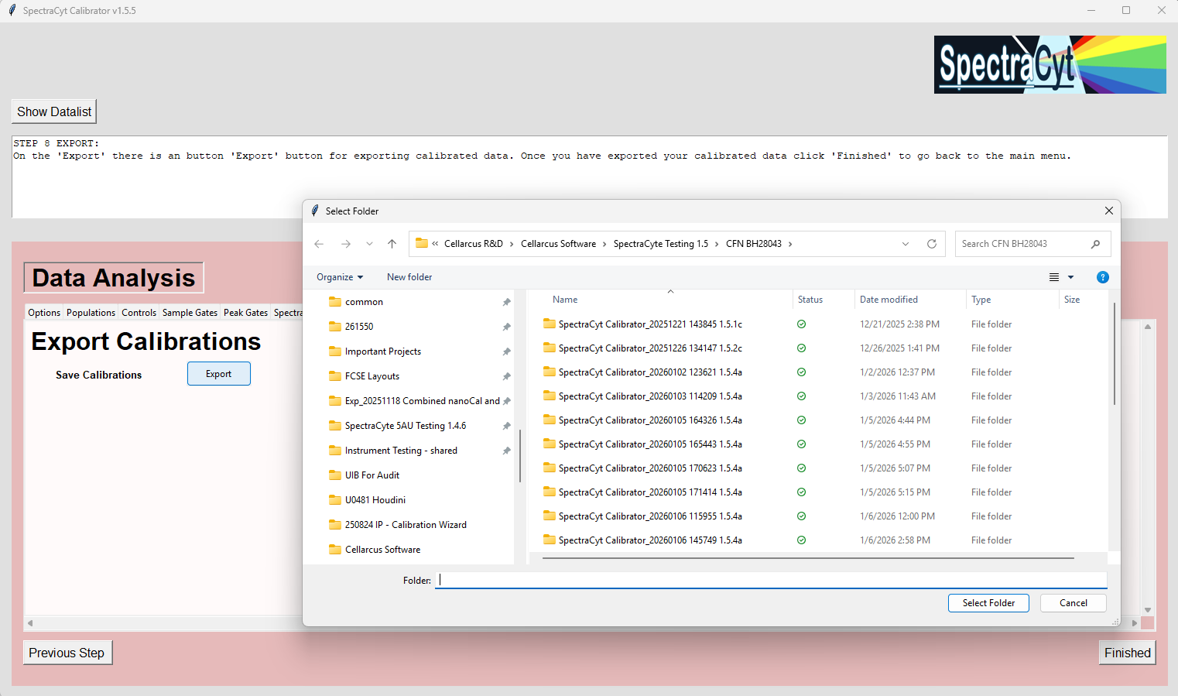

Slide 11
Apply Calibrations

Slide 12
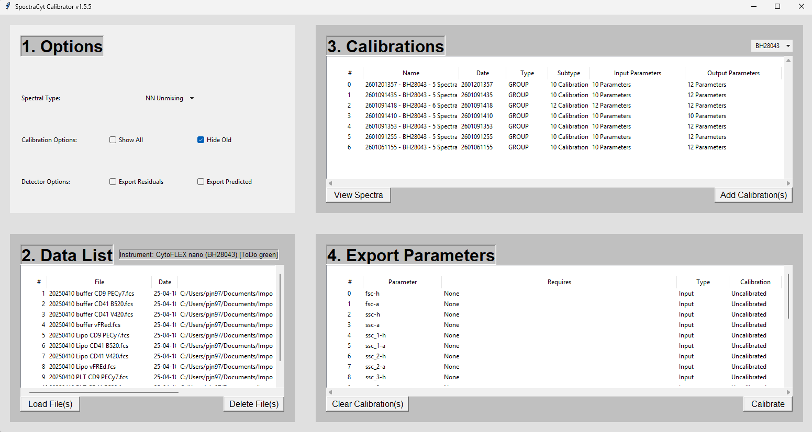

Slide 13
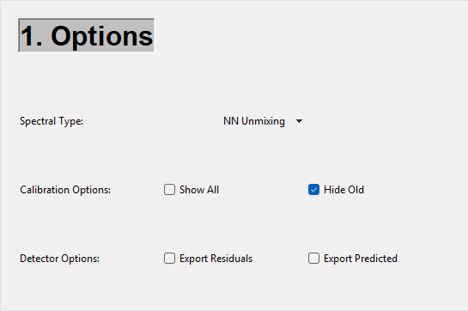
Choose Unmixing/Calibration Type
Show/Hide Individual Calibrations
Show/Hide Old Calibrations
Export Predicted Parameters
Export Residual Parameters

Slide 14
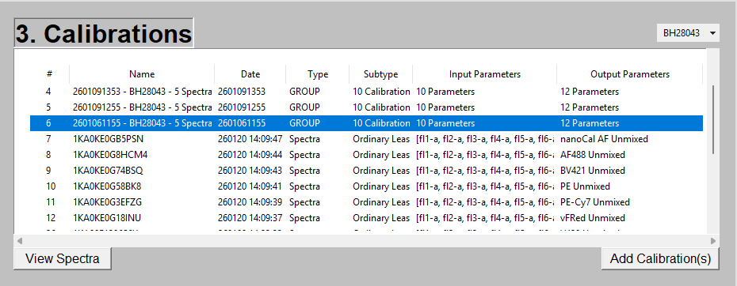
Select Calibration Group
Select Individual Calibration
View Calibration Regression Results or Spectra
Add Selected Calibrations/Groups

Slide 15
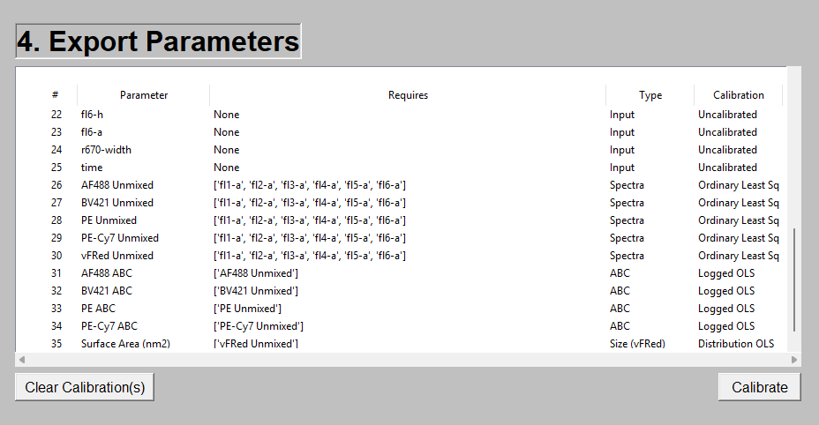
Raw Parameters Already in the Data File
Calibrated Parameters that will be Exported in New Files
Clear Calibrations and Calibrated Parameters
Calibrate the Data and Export New Files

Slide 16
Spectra View

Slide 17
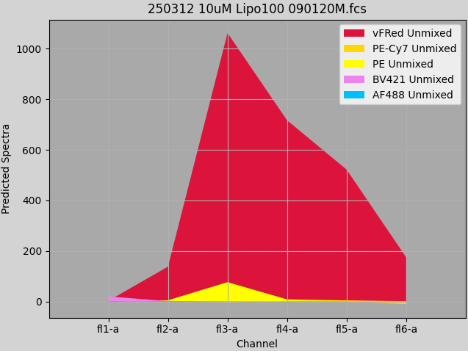
CytoFlex Nano – Predicted Spectra
Predicted spectra according to an unmixing model
Individual Unmixed parameters converted back to raw
Note: CytoFLEX Nano has limited detectors which impacts unmixing

Slide 18
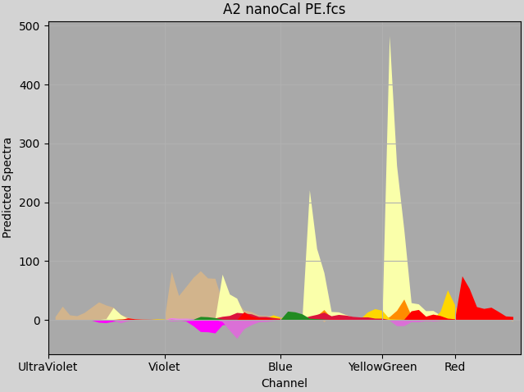
Cytek Aurora 5L – Predicted Spectra
Predicted spectra according to an unmixing model
Individual Unmixed parameters converted back to raw
Note: Autofluorescence unaccounted for

